Slide 1
CEIS101 Final Course Project- Smart Home Automation and Security System
Presented By: Jacob Dynes

Slide 2
Contents
Module 2 Project- Circuit Simulation
Module 3 Project- Inventory of Parts, Circuit Building, and Displaying Messages
Module 4 Project- Adding Door Sensor to Smart Home System
Module 5 Project- Adding Distance Sensor to Smart Home System
Module 6 Project- Adding Automated Light to Smart Home System

Slide 3
Introduction
Developing a Smart Home Automation and Security System
Using Tinkercad to virtually design the prototype
Using the Tech Core Kit to build the design components

Slide 4
Ceis101Module 2 Project- circuit simulation

Slide 5
Led light simulation

Slide 6
Programming Test

Slide 7
Ceis101 module 3 Project- inventory of parts, circuit building, and displaying messages

Slide 8
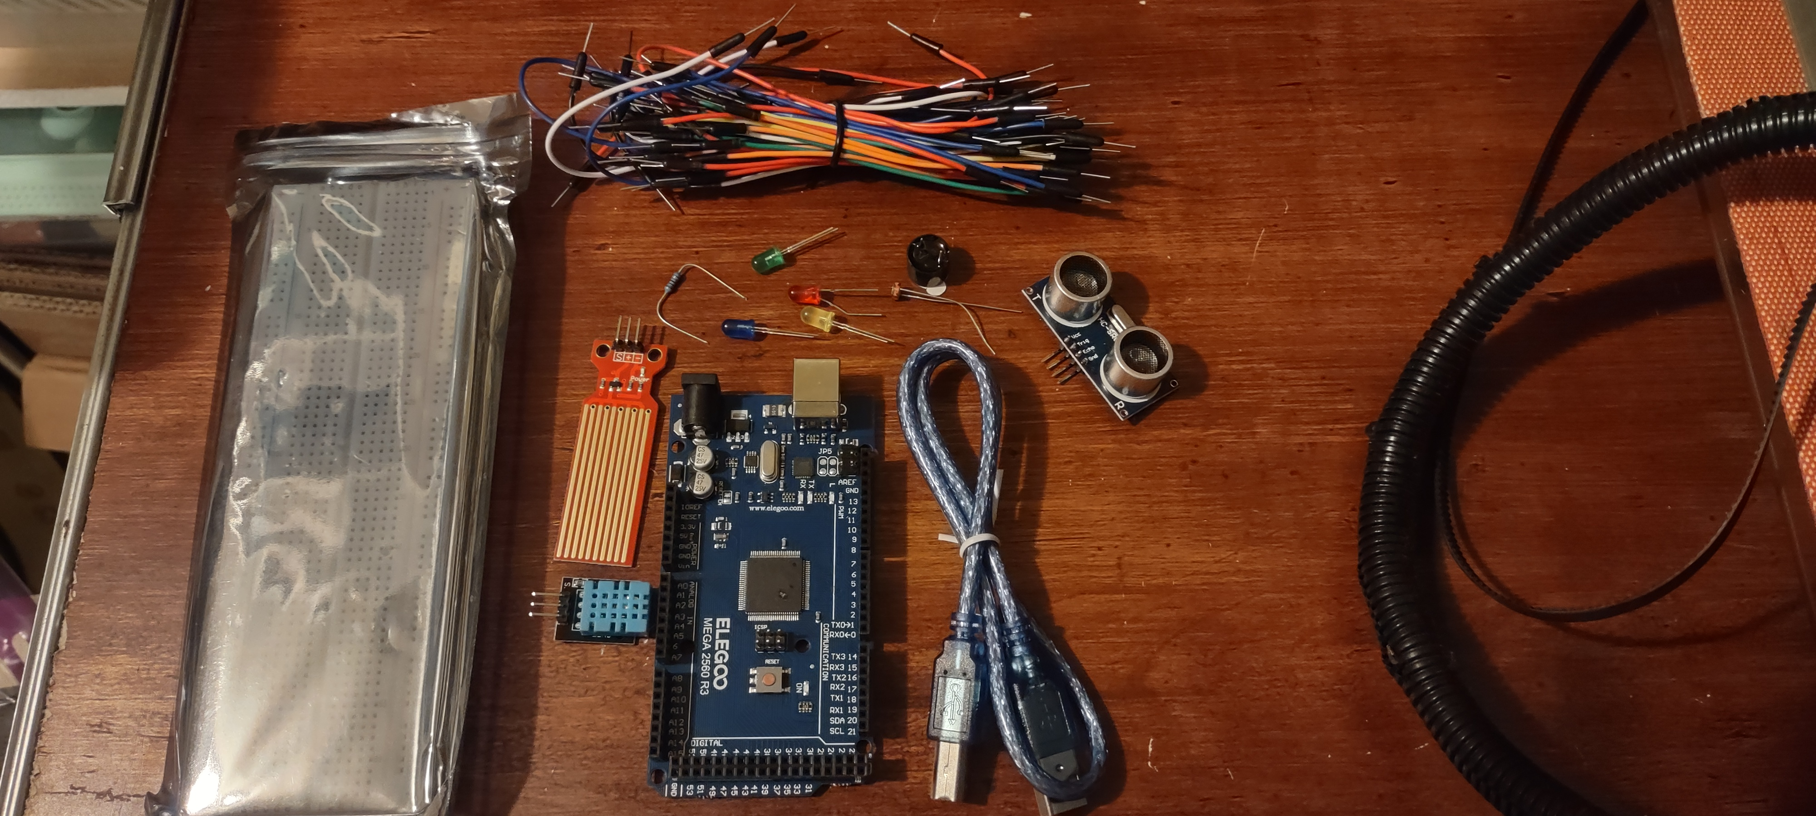
Organization of Project Components (picture)
Arduino Mega 2560
Breadboard
Resistor 10kΩ
LEDs
Ultrasonic Sensor
Active Buzzer
Photoresistor
Wires
USB Type B cable

Slide 9
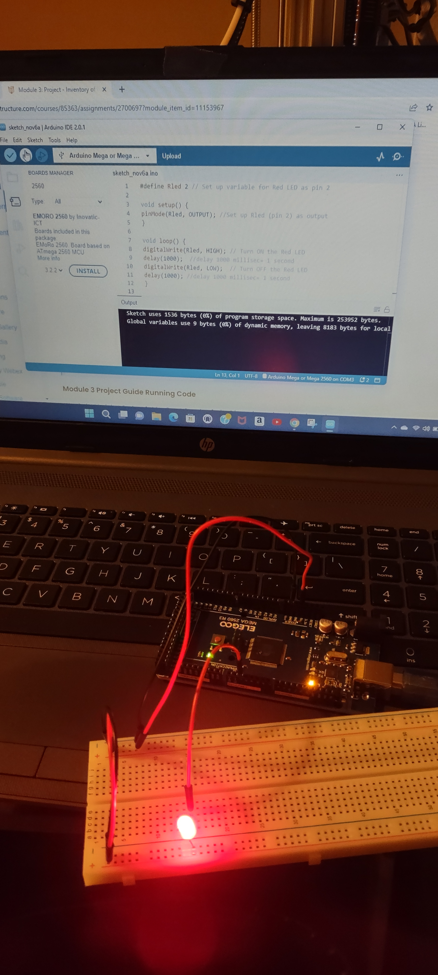
Circuit with red LED on

Slide 10
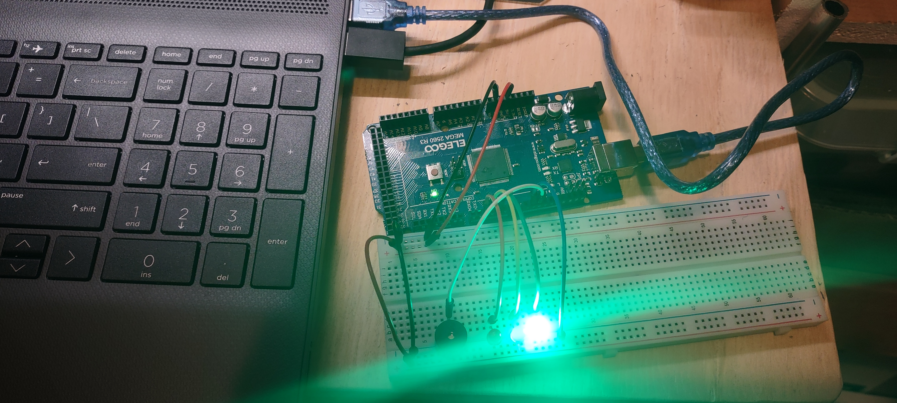
CIRCUIT OF DOOR CLOSED WITH GREEN LED ON

Slide 11
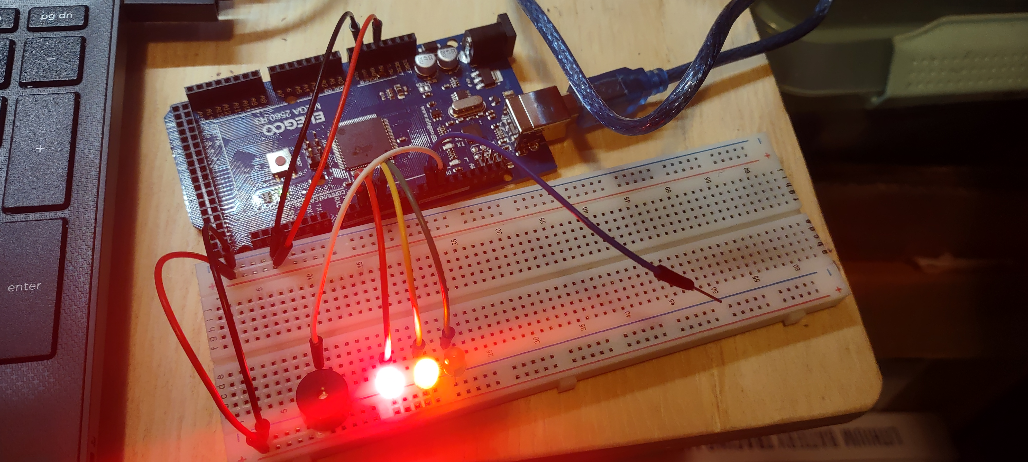
CIRCUIT OF DOOR OPEN WITH GREEN LED OFF

Slide 12
CEIS101 MODULE 4 PROJECT-
ADDING DOOR SENSOR TO SMART HOME SYSTEM

Slide 13
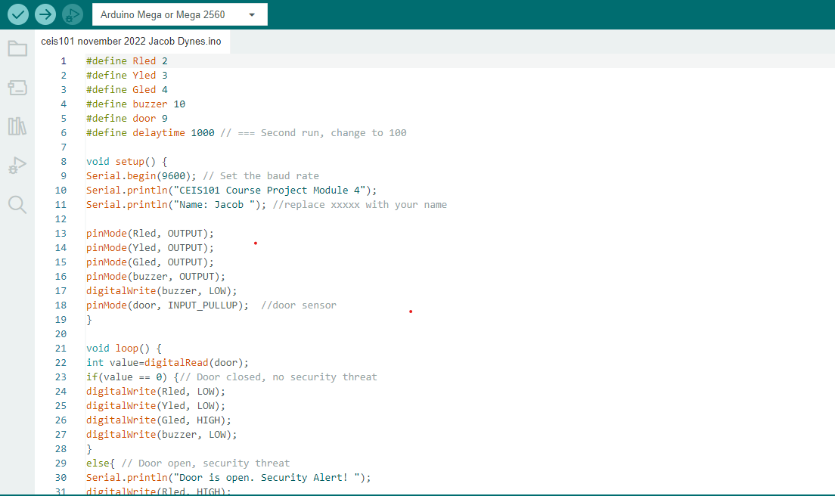
Arduino Code

Slide 14
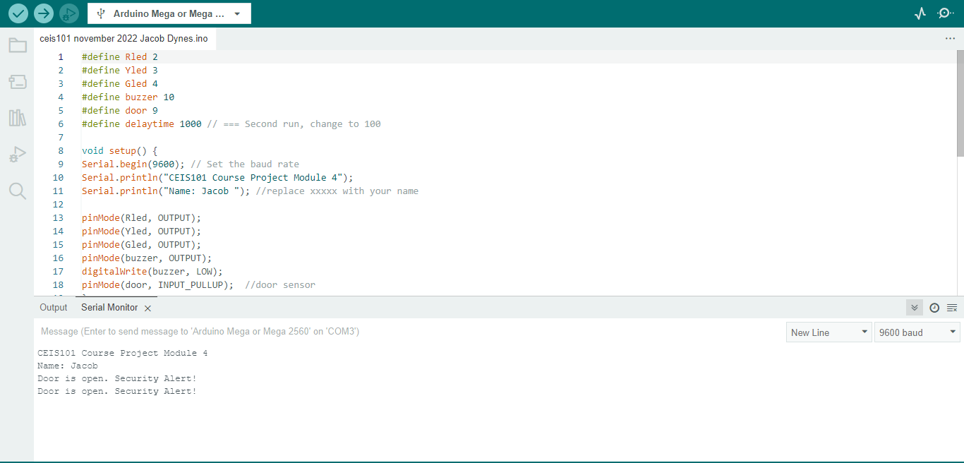
Arduino code with Serial Monitor

Slide 15
Ceis101 module 5 PROJECT- Adding Distance Sensor to Smart Home System

Slide 16
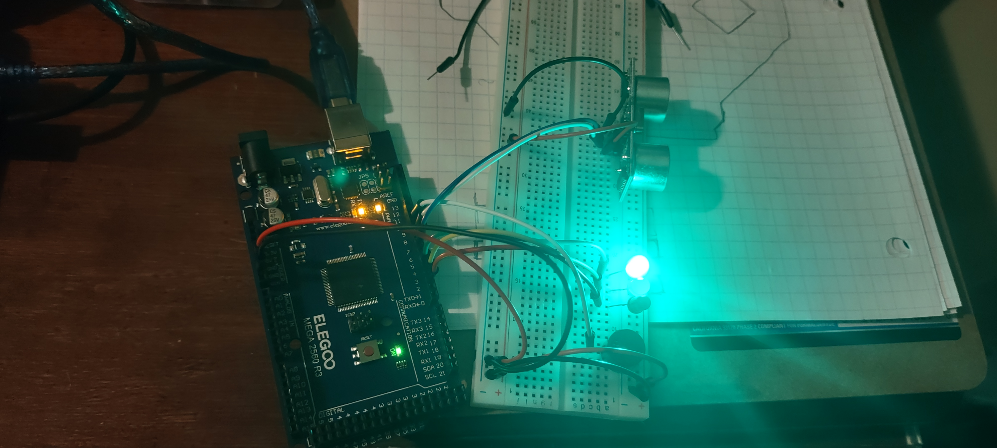
Circuit with green LED on

Slide 17
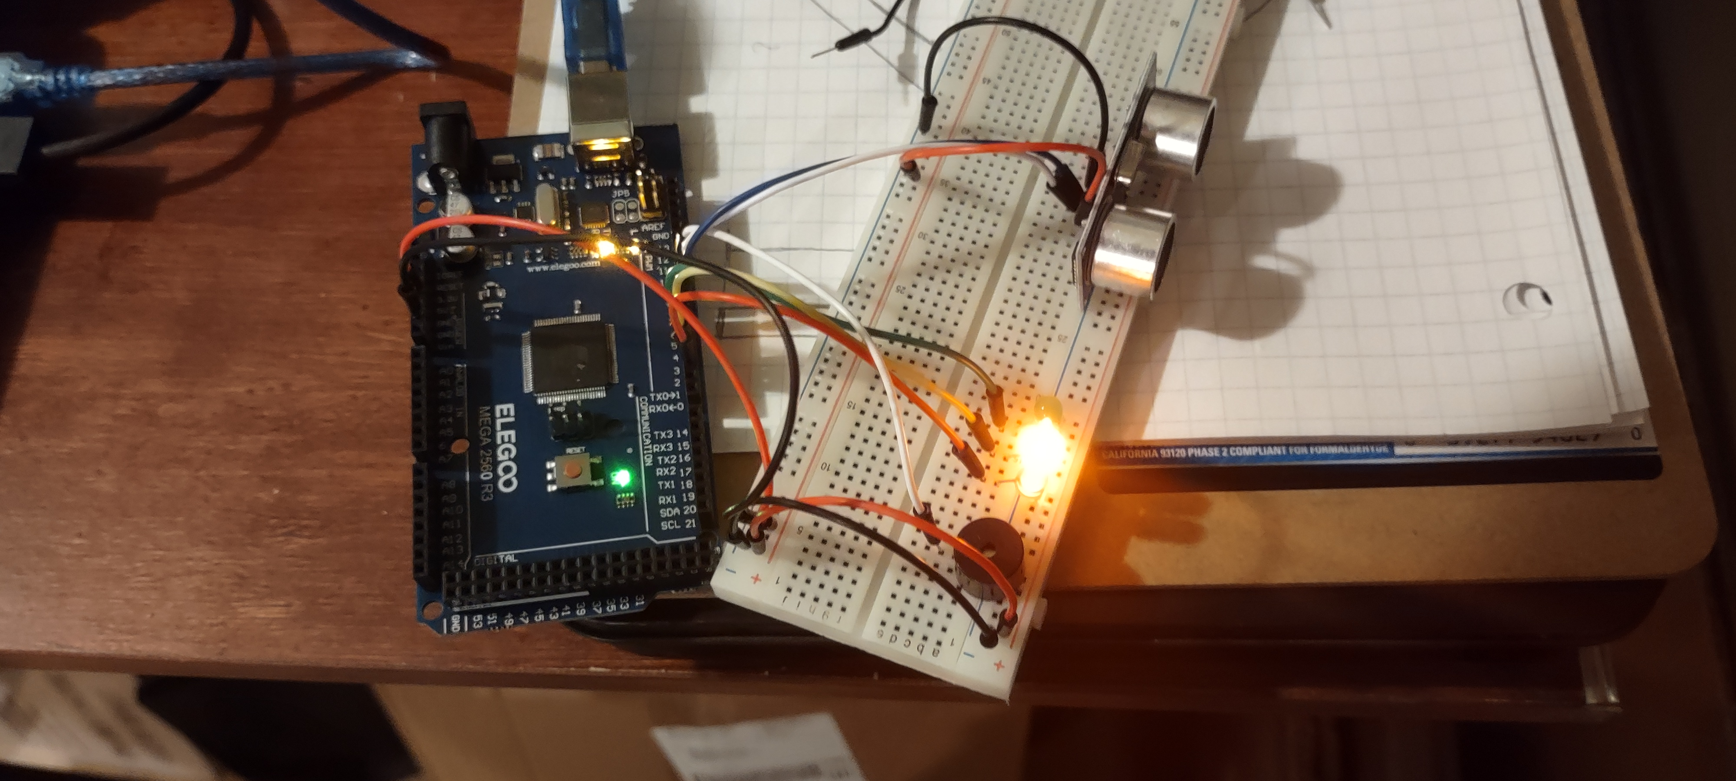
Circuit with yellow LED on

Slide 18
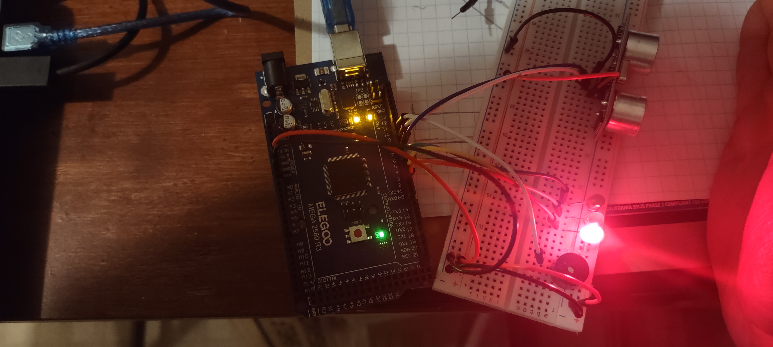
Circuit with red LED on

Slide 19
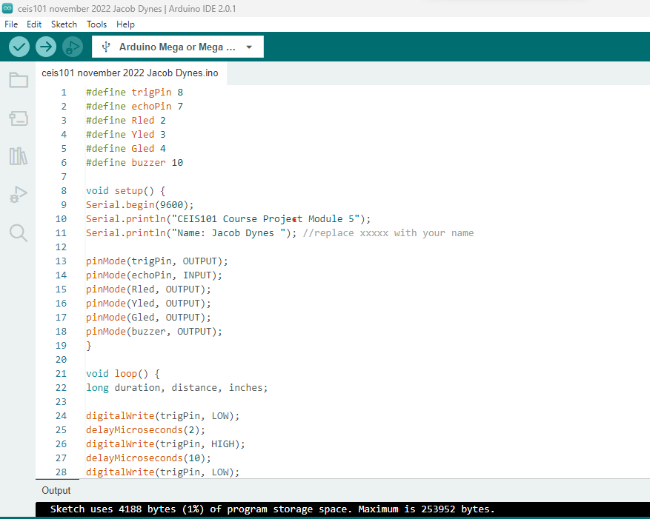
Arduino Code

Slide 20
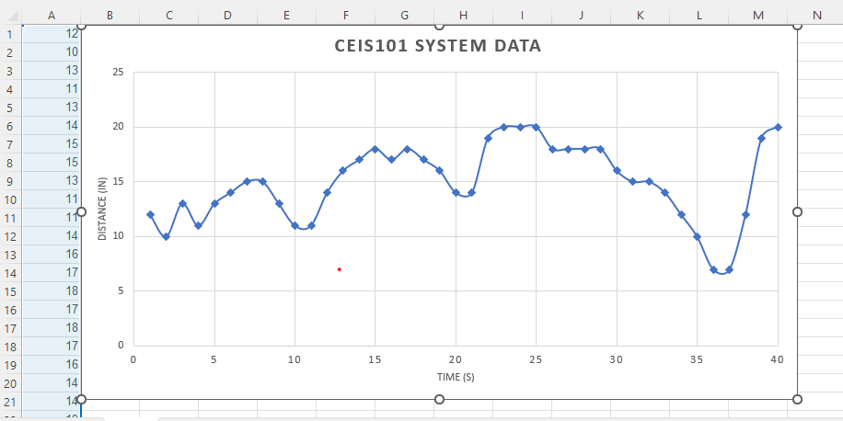
Plot of data over time (graph Is from Excel)

Slide 21
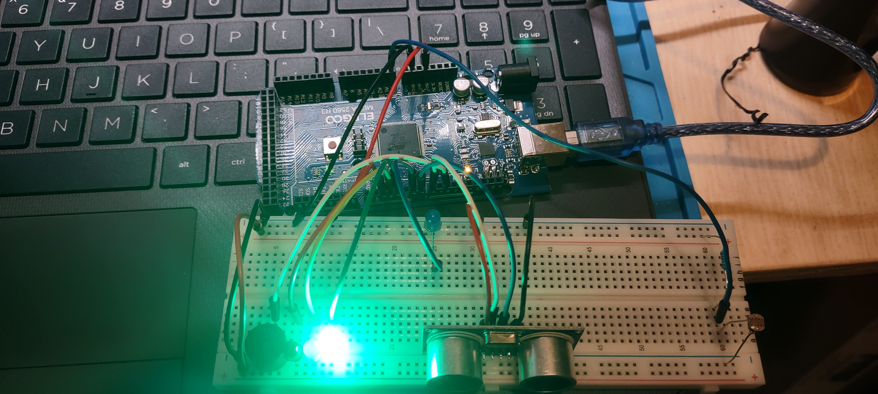
Circuit with automated LED off

Slide 22
CEIS101 MODULE 6 PROJECT-
ADDING AUTOMATED LIGHT TO SMART HOME SYSTEM

Slide 23
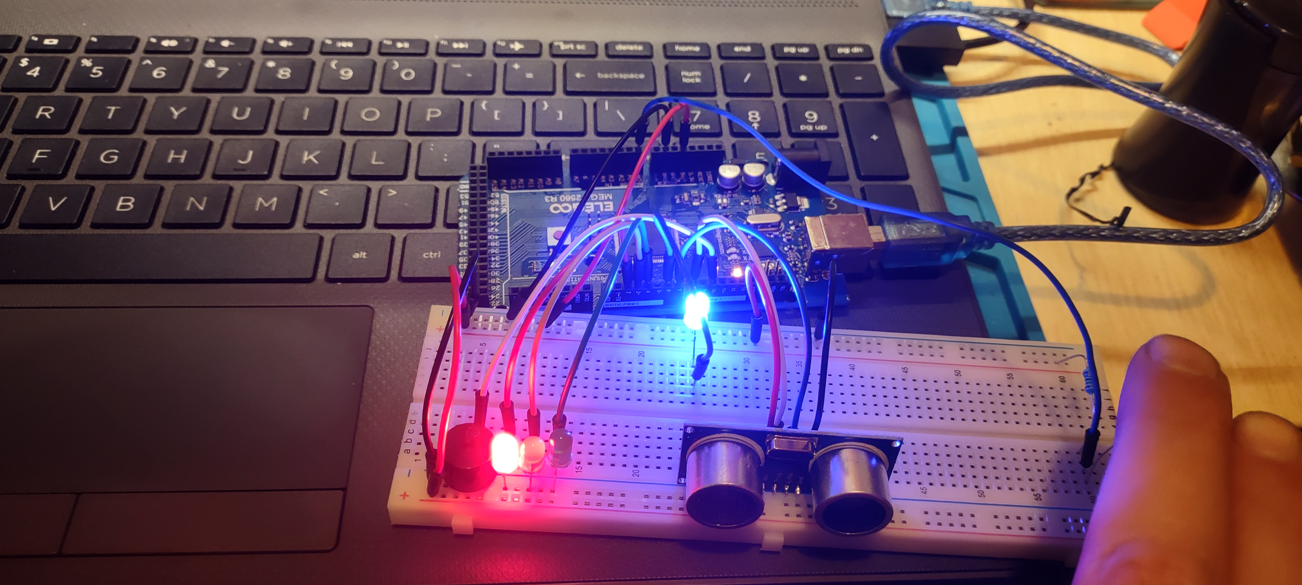
Circuit with automated LED on

Slide 24
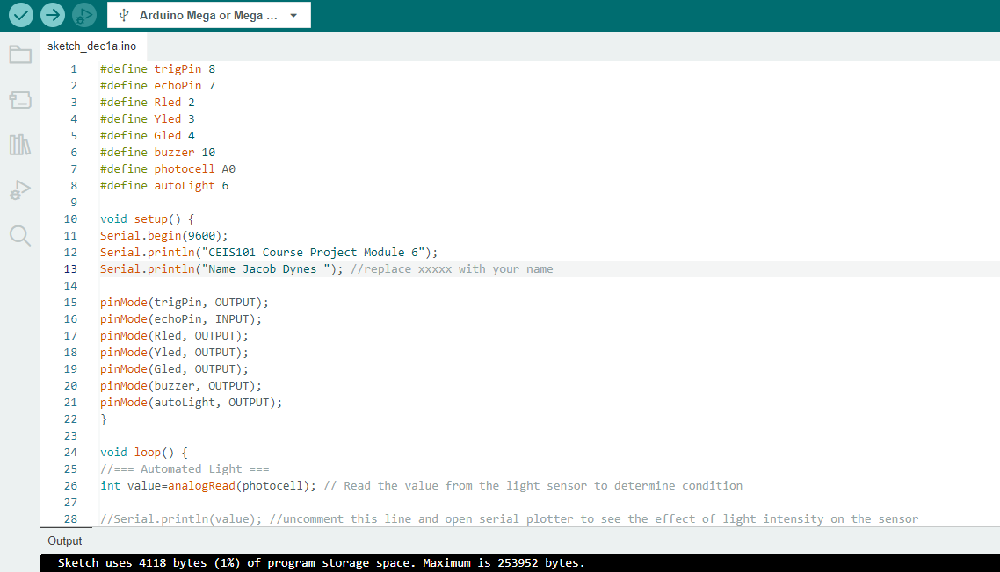
Arduino Code

Slide 25
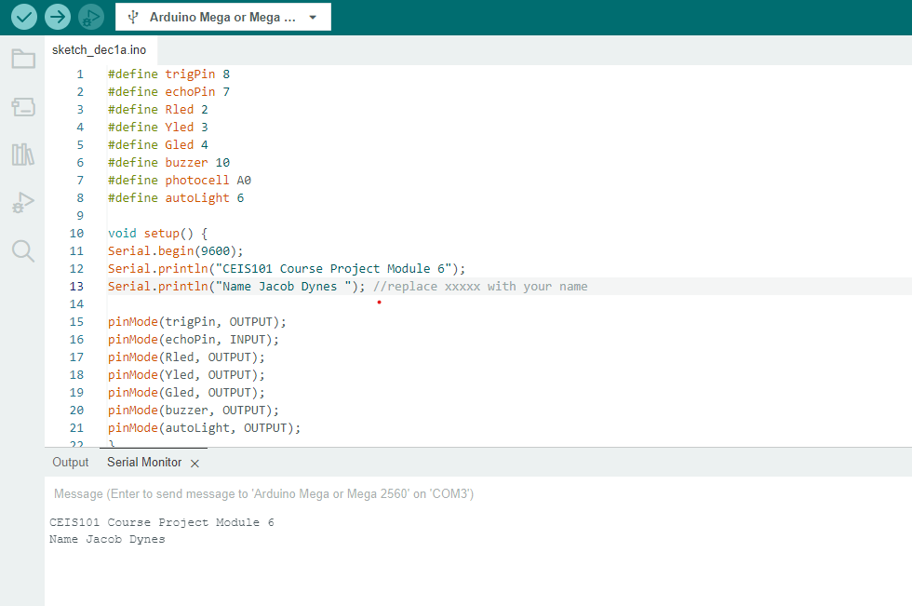
Serial Monitor with code

Slide 26
challenges
The first challenge I ran into was I did not have the code for the Arduino board. I learned where to download it in the Arduino IDE.
The second challenge was that the bread board wires can be sensitive, they wiggle in the bread board causing the system to fail.

Slide 27
Career skills acquired
Hardware building and Automation
Programming
An understanding of IoT
Basic business intelligence
PowerPoint experience
Simulated circuit designing

Slide 28
conclusion
Over the course of this class, I was able to expand my knowledge and experience of Arduino and Tinkercad.
I learned the beginnings of programming simulated circuit boards that I had not previously had experience with.
I also learned about the depth of IoT and the importance of understanding the interconnectedness of its uses in various fields and applications.

Slide 29
Thank You
Jacob Dynes
nathandynes@gmail.com
Website address

