Slide 1
Final Course Project
Intro to Operating Systems
CEIS106 Module 8
Presented By Jacob Dynes

Slide 2
CONTENTS
Week 2:
Navigate the Linux filesystem tree
Create directories and files
Copy and remove directories and files
Locate directories and files
Week 3: Create a shell script
Change script file permissions
Set the PATH variable
Make the PATH variable permanent
Week 4:
Add users and groups in CLI
Test user and group settings
Add users in GUI
Remove users and groups
Week 5:
Discover host IP configurations
Manage network interfaces
User network utilities
Week 6:
Monitor processes
Monitor user activities
Monitor network bandwidth usage

Slide 3
Module 2 Navigate the Linux filesystem tree Create directories and files Copy and remove directories and files Locate directories and files

Slide 4
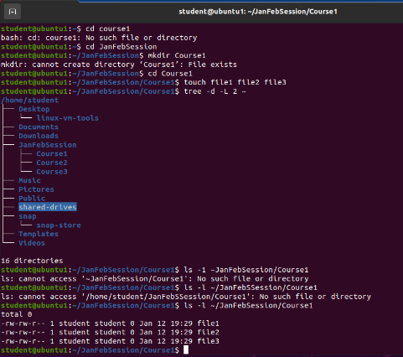
Create directories and files

Slide 5
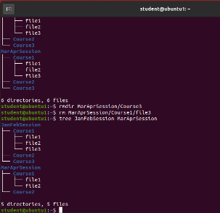
Copy and remove directories and files

Slide 6
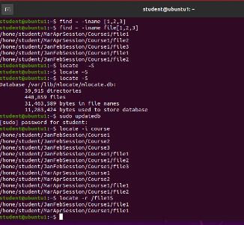
Locate directories and files

Slide 7
Module 3 Create a shell script

Slide 8
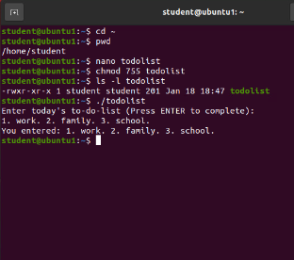
Change script file permissions

Slide 9
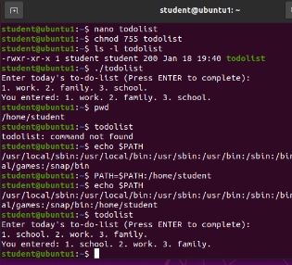
Set the PATH variable

Slide 10
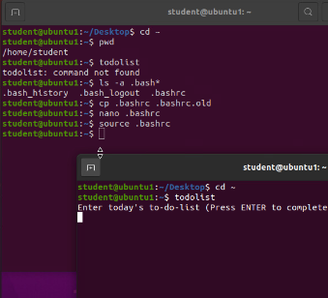
Make the PATH variable permanent

Slide 11
Module 4 Add users and groups in CLI Test user and group settings Add users in GUI Remove users and groups

Slide 12
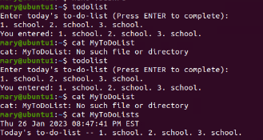
Test user and group settings

Slide 13
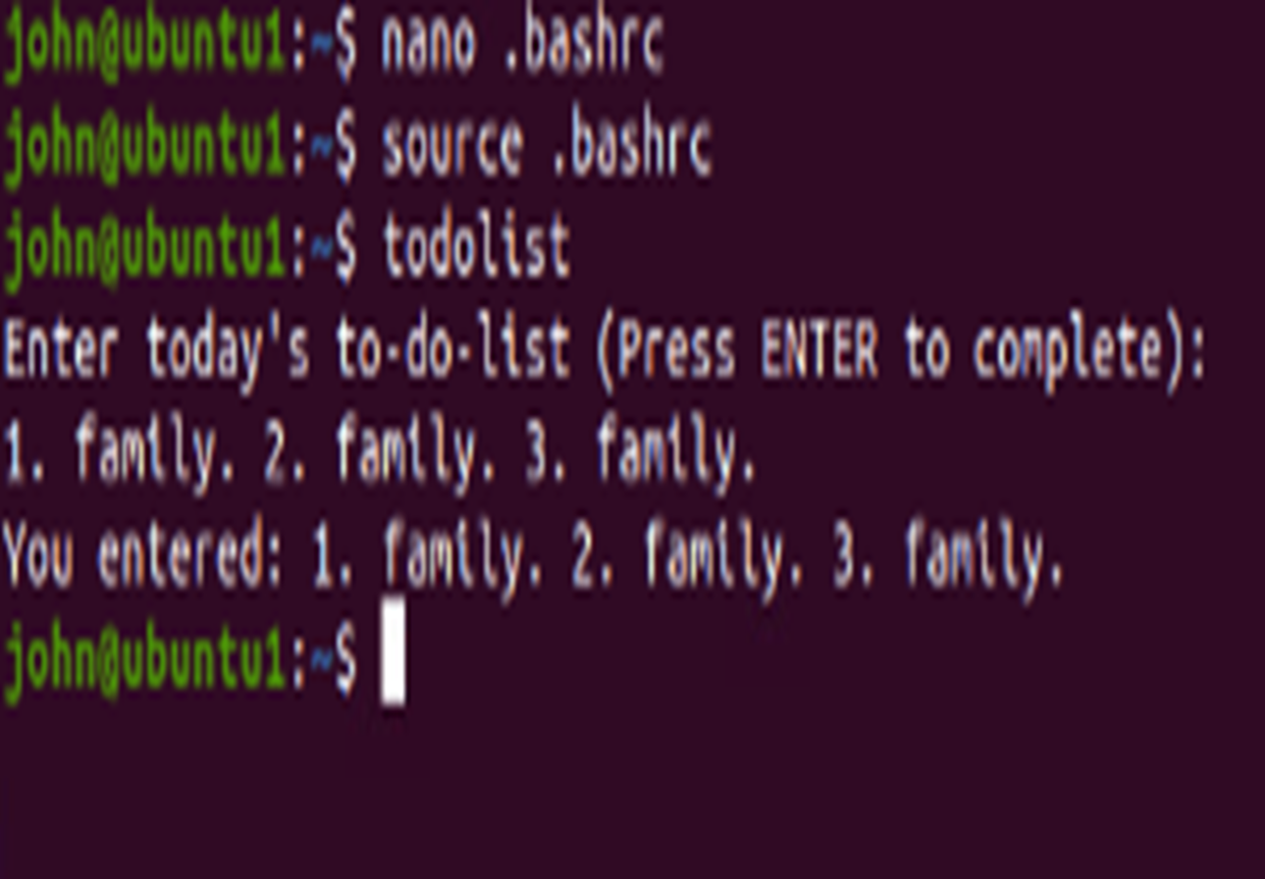
Add users in GUI

Slide 14
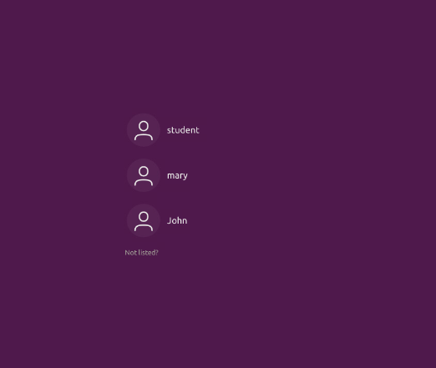
Remove users and groups

Slide 15
Module 5 Discover host IP configurations Manage network interfaces User network utilities

Slide 16
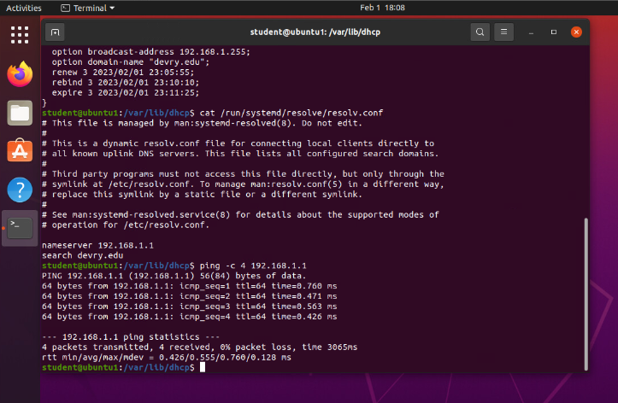
Discover host IP configurations

Slide 17
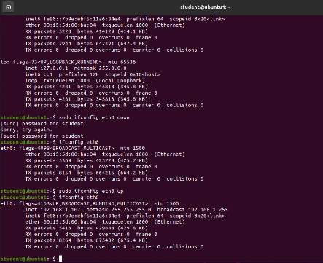
Use network utilities

Slide 18
Module 6 Monitor processes Monitor user activities Monitor network bandwidth usage

Slide 19
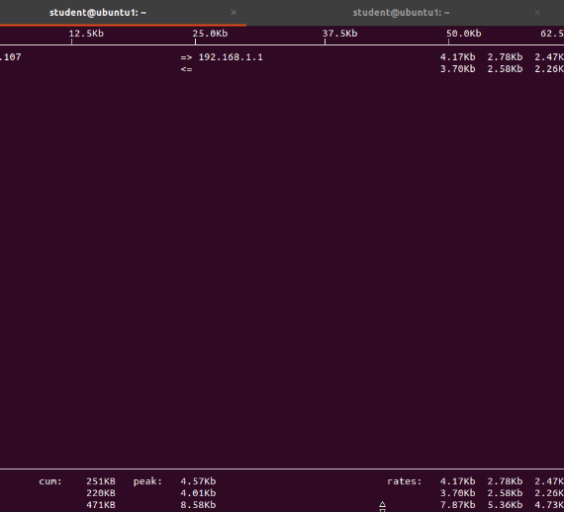
Monitor network bandwidth usage

Slide 20
Skills Obtained
Navigating Linux Operating Systems
Improved typing skills
The ability to navigate and use the Terminal in Linux
To read and write sudo commands In Linux Terminal
Creating shell script
Able to monitor, discover host IP configurations and manage network interfaces
Able to add and remove users
Able to create folders and remove them

Slide 21
Difficulties I had in this class
Typing without mistyping.
While typing commands one mistake can send you to the wrong location or it would not work at all.
Navigating and understanding some of the commands I typed in the terminal.
Learning and retaining the layout of the terminal.

Slide 22
THANK YOU Jacob Dynes jdynes1.wixsite.com/engineering

