Slide 1
Final Project
Devry University
Class SEC285
June 2024
Presented By Jacob Dynes

Slide 2
Content
Module 2: File Encryption
Module 3: Question, Nmap scan
Module 4: BYOD Security policy
Module 5: Common-auth Configuration File, MFA Logon Screen
Module 6: Nmap, NetCat, Wireshark, and Nessus.

Slide 3
Module 2 Asymmetric Key Encryption

Slide 4
File Encryption
This screenshot should show the following.
Content of the plaintext file
Content of the encrypted file

Slide 5
File Decryption
This screenshot should show the following.
The encrypted file being listed by itself
The decrypting process
Both the encrypted file and the original plaintext file being listed

Slide 6
Module 3 Stateful Firewall

Slide 7
Question
What effect does the sudo iptables --policy INPUT DROP command have on the access to computing resources?
Answer here: . This means that all incoming traffic that does not match any of the existing rules in the INPUT chain will be dropped
Form the instructions, Note: Each open port provides a means by which an attacker may gain access to the server. Our goal is to only allow web (HTTP and HTTPS), email (SMTP), name resolution (DNS), and SSH services, as listed below.
References: infosec learning

Slide 8
Nmap Scan
This screenshot should show the Nmap scan result of the Linux Server VM.

Slide 9
Module 4 Bring Your Own Device (BYOD) Security Policy

Slide 10
Overview:
Most modern-day businesses almost entirely run on the use of tablets, laptops, or desktop computers; with smartphones often being a frequently used resource as well. Common threats to all devices used by a company are data breaches through unsecured networks, malware, power or internet outage, IP spoofing, and phishing emails/messages.
2. Purpose:
Having timely discoveries will reduce the volume of loss or stolen data, the workload of the personnel/department in charge of securing, or recovering, said data, and the impact to the potential customers of the loss, or stolen, data.
3. Scope:
Personal devices are only allowed when the company VPN is active. First, one must receive approval from a supervisor, or manager, to utilize the company’s internet, or services. Use of personal devices for work purposes only.
4. Policy:
No personal device is permitted for use unless approved by a supervisor, or manager.
The devices must be maintained with all up-to-date software and company VPN security. The ones responsible for remediation is the IT department within the company.
5. Policy Compliance:
When employees do not follow the security policy, an investigation will begin to determine if it was intentional or negligence.
An employee who fails to uphold the security policy will be subject to disciplinary actions, up to suspension, and including possible, termination of employment.
6. Related Standards, Policies, and Processes:
HIPAA or PCI-DSS standards will be only accessible through our company VPN activated computers for security and privacy.

Slide 11
7. Definitions and Terms:
Think of terms such as BYOD, mobile devices, and CIA. Define them here.
BYOD: Bring Your Own Device
Mobile device: a device that is mobile, usually handheld, capable of making phone calls, text messaging, with connection to a service provider.
Tablet: a mobile handheld touchscreen computer, not necessarily phone call, text message capable, also not necessarily connected to a service provider.
Laptop: a mobile computer
Desktop: a stationary computer
CIA: confidentiality, integrity, and availability
8. Revision History:
Date of change | Responsible | Summary of change
August 2019 | SANS policy team | Updated and converted to new format
May 2024 | Jacob Dynes | Updated policy information

Slide 12
Module 5 Multifactor Authentication (MFA)

Slide 13
Common-auth Configuration File
This screenshot should show the entry that indicates the use of the Google Authenticator module.

Slide 14
MFA Logon Screen
This screenshot should show the logon screen where a verification code is required.

Slide 15
Module 6 Vulnerability Assessment

Slide 16
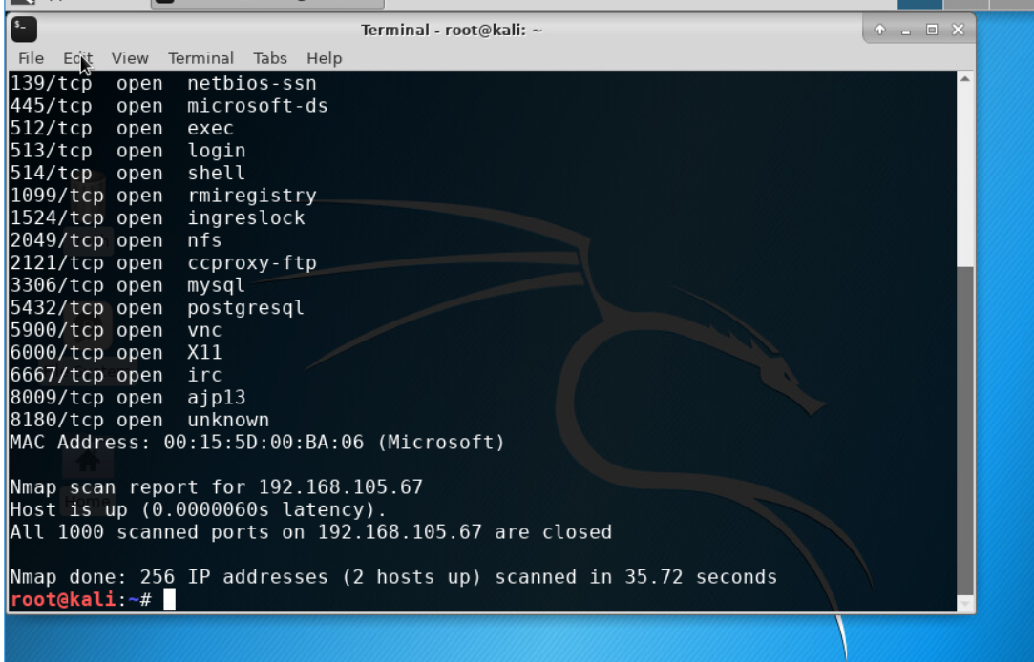
Nmap
This screenshot should include the scan result showing both the Kali and Linux Server VMs.

Slide 17
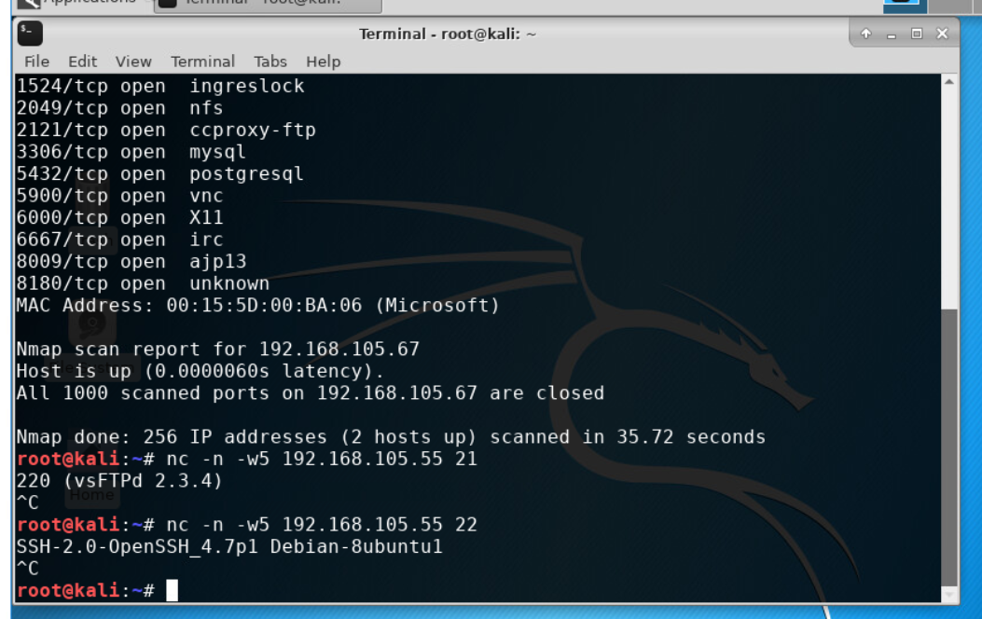
NetCat
This screenshot should include the scan result showing both the Kali and Linux Server VMs.

Slide 18
Wireshark
This screenshot should include the Wireshark—Follow TCP Steam window showing the Telnet username and password.

Slide 19
Nessus
This screenshot should include the high-level view of the Nessus vulnerability scan report (showing categories of vulnerability in different colors).

Slide 20
Challenges I faced
I had couple of challenges with this class. The main problem I faced was the application I used was not functioning properly. Because of this I had to restart the application multiple time to be able to finish the assignments.
The other issue I faced is that I am still getting used to my new keyboard, so I kept typing wrong thus delaying my progress.

Slide 21
What skills I have obtained
I have gained a better understanding of how security systems function.
I have learned how to set up a security system.
I have learned more about security policies.

Slide 22
Conclusion
This class helped me learn about security systems, and how to apply my knowledge with a simulation application.
I liked this class because the information presented was easy to understand
I look forward to using what I have learned in a job setting.

